Slide 1

3D ICs: technology, system design challenges, solutions & benefits
Dragomir Milojevic

Slide 2
Scaling is dead, long live the scaling!
Advanced patterning techniques (SADP, EUV, SAQP, …) enable Contact Gate Pitch (CGP) & Metal Pitch (MP) scaling
→ 0.5 area reduction node-to-node
power & performance scale too
sources: imec

Slide 3
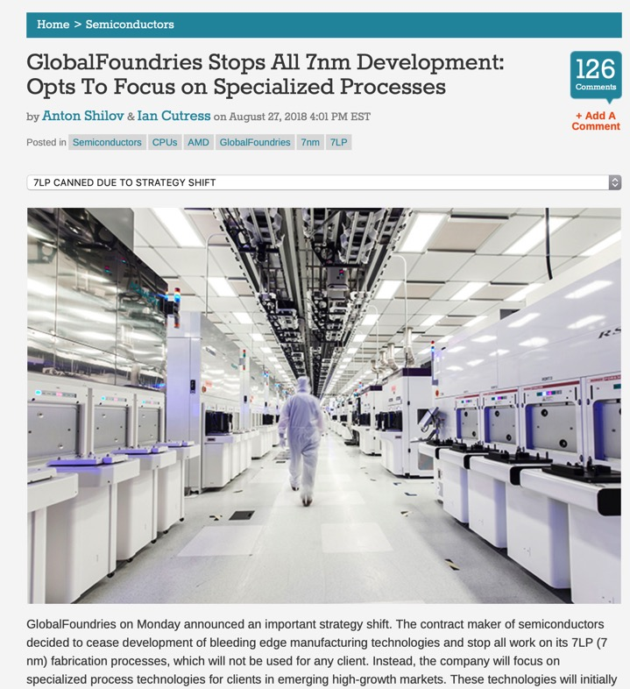
Moore’s law still on ?
Some reasons NOT to believe so (this is a short list …)
System design becoming more & more complex
Routability becomes major challenge
Yield is (seriously) limiting the die size
HPC dies are smaller and smaller
Scaling CGP & MP is becoming more & more expensive
4th foundry abandons next gen CMOS (Aug. 2018) → Today only 3 remain in game (you can guess which ones …)

Slide 4
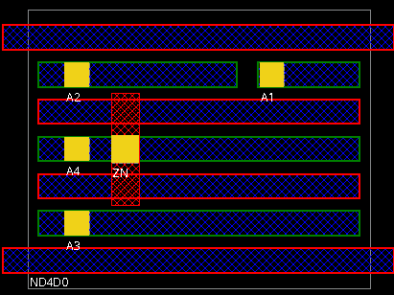
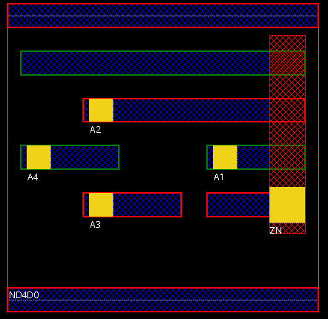
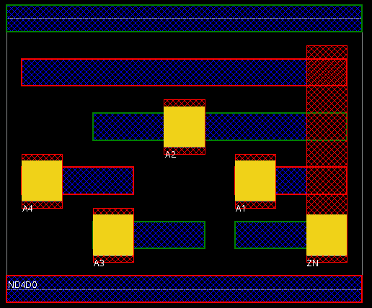
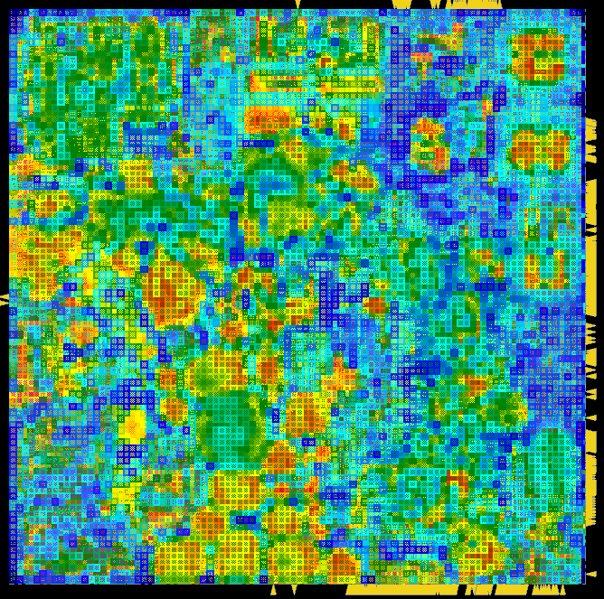
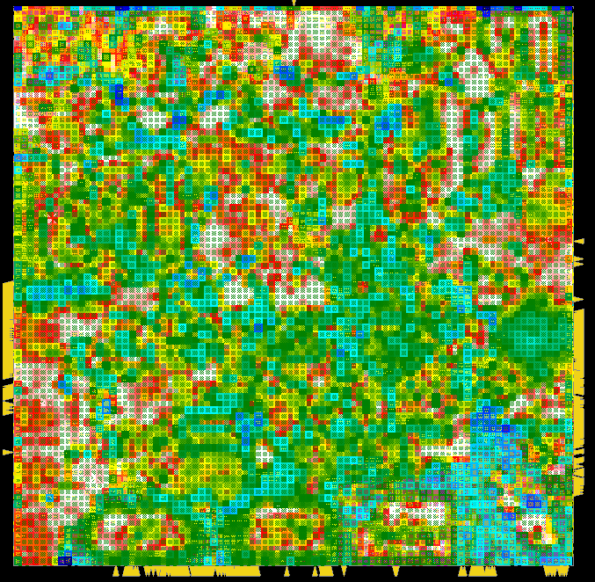
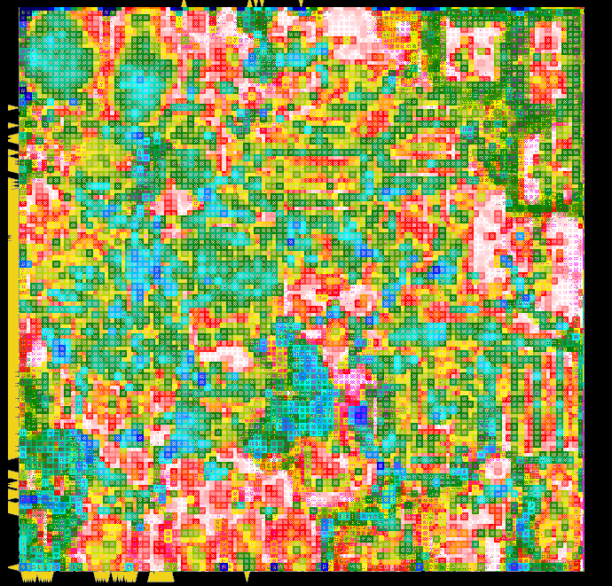
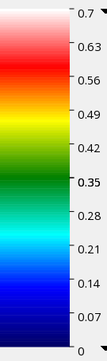
Design complexity increases
CPP likely to stop @30nm → std cell height reduced to 7.5, 6 & 5Tracks
Cell height reduction causes pin density to increase at design-level
Higher pin-density aggravates congestion & design routability
Standard cell (ND4D0)
7.5T
6T
5T
240nm
192nm
160nm
Design
7.5T
6T
5T
High
Pin density
Low

Slide 5


Area needs
Next gen system will be more parallel (more cores per CPU)
More cores mean more & deeper cache memories
We need more IC area on the top of CMOS scaling
kB /core
M5
M6
S7
M7
L3
added
T4
T5
T2
T3
Nº of cores
real / projected
M5 (28nm)→ M6(28nm) → M7(20nm) → S7(20nm)
T2 (65nm) → T3(40nm) → T4(40nm) → T5(28nm)

Slide 6
Cost of advanced CMOS
More cores & more memory mean more connectivity (more wires)
Total wafer cost increases for advanced CMOS
BEOL cost doubles from 14 to 7nm
Wafer cost breakdown
(relative to 14nm)
real projected

Slide 7
3D technology
Welcome to :

Slide 8
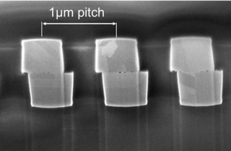
Key 3D technology enablers
Through Silicon Vias (TSVs) – good Aspect Ratio (AR) is required for higher interconnect density and to keep wafer thin
Minimum ø of 2µm (for min area overhead) & 40µm depth (complex to make)
Micro-bumps – bump flip-chip technology 40µm, significantly larger than 5µm øTSVs (don’t introduce area penalty like TSVs)
To increase the inter-die connectivity density size needs to shrink to 10µm
Hybrid W2W bonding – Cu pads of 1.6µm pitch, could be 0.8µm (aggressive)

Slide 9
Stacking flavors (die orientation)
Face-to-Back (F2B)
TSVs of the bottom die connect to the FEOL of the top die
TSVs & ubumps may not be aligned (presence of backside metal layers)
Not so dense 3D interconnect
Face-to-face (F2F)
Micro-bumps or Cu-pads, more dense 3D interconnect
Only two dies in the stack
Still need TSVs so get out (IO), but their numbers is small (<1k)

Slide 10
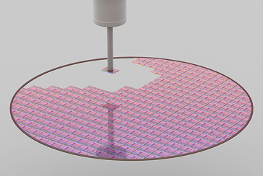
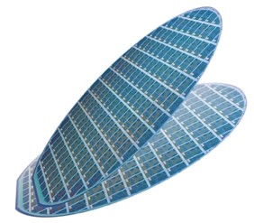
Assembly level
Die-to-wafer (D2W)
One wafer processed & sliced
Single dies picked & placed on the top of another die at wafer level
Allows Known Good Die integration (test before stack) → increases yield, at the expense of stacking speed
Wafer-to-wafer (W2W)
Increased 3D stacked IC processing throughput
Lower 3D stack yield (because of compound defaults)
Typically smaller 3D pitch

Slide 11
3D tech overview

Slide 12
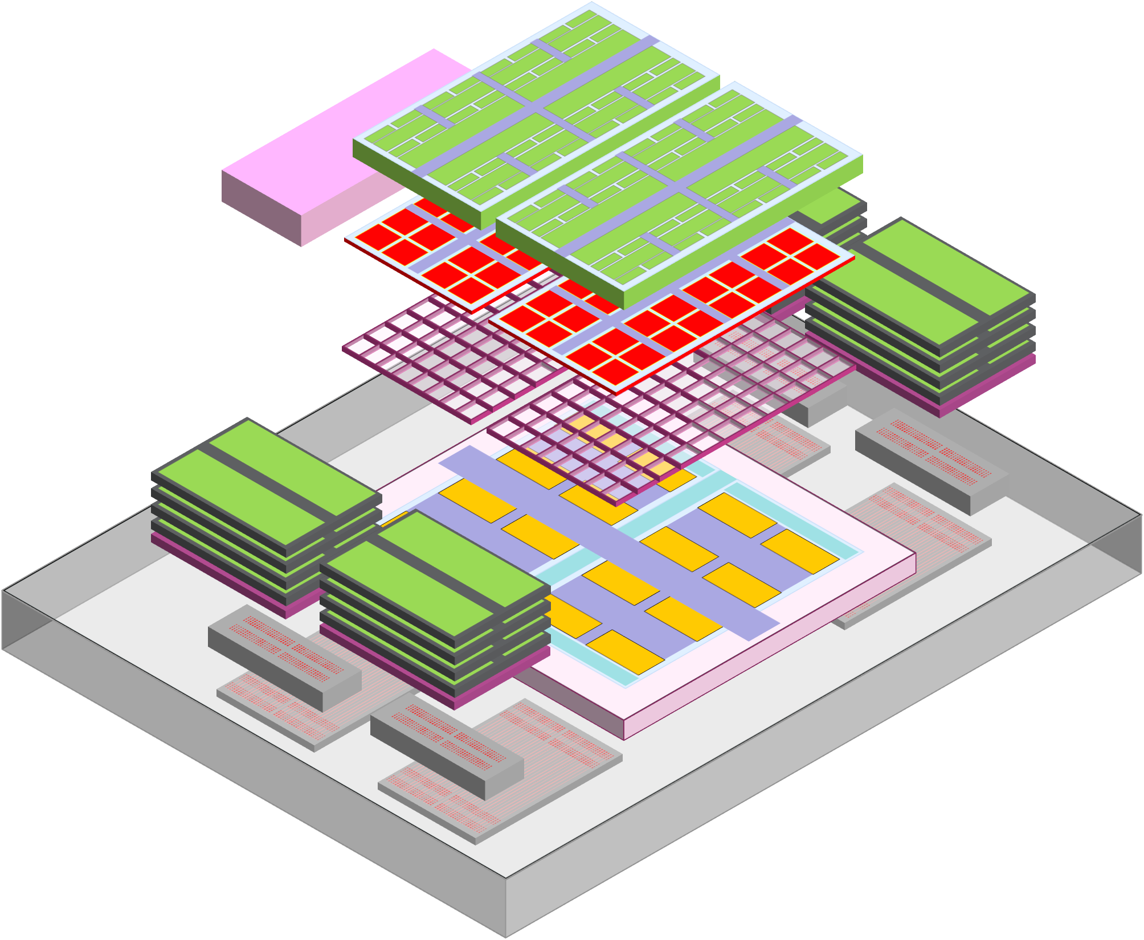
3D packaged system
Memory layer
SRAM cache (64MB to 1GB)
FEOL optimized for SRAM
Limited BEOL
Core layer
High performance FEOL
Complex BEOL
Possibly multiple dies
Power Delivery Network
Back-side metal layers
uTSV directly to cells
Better IR drop & front side routing
Dense memory layer
Upper cache layers and/or central memory (DRAMs)

Slide 13
3D system design challenges

Slide 14
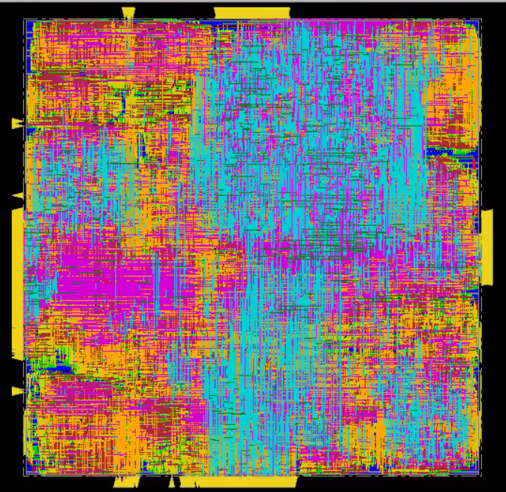
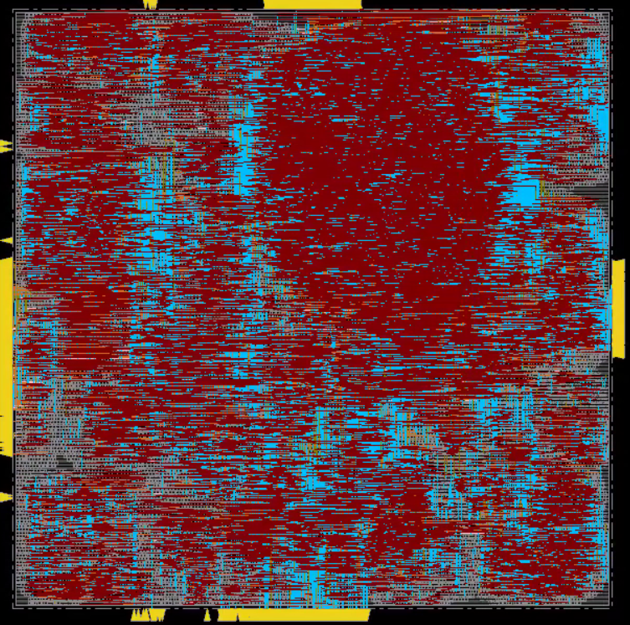
How to design 3D systems?
Native 3D placement
Die-by-Die flow
RTL
RTL
Available!
Work on sign-off
Work in progress
Std. synthesis
2D PDK
Synthesis
Single
netlist
Netlist
partitioner
Partition
directive
Die1
Floorplan
3D P&R
3D PDK
Die2
Floorplan
Top Die
netlist
Top Module
netlist
Bot Die
netlist
Die1
Die2
2D P&R
2D P&R
Holy grail, disruptive & huge dev. effort (e.g. 3D clock tree synthesis)
It needs to be 3D pitch driven
Works for 3D stacking & sequential FEOL
Can use existing 2D tools
How to supply partition directive ?
Manual – Logic/Memory-on-Logic
Automated – Logic-on-Logic

Slide 15
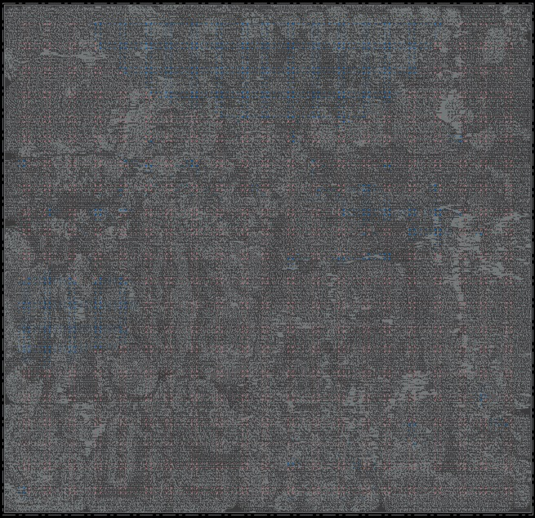
Partitioning automation
Hierarchical clustering of gates after 2D P&R
Design transformed into graph:
vertex – area of each gate-cluster
Wiring inside intra-cluster wirelength; not compressible by 3D
edge – inter-function connectivity (nº of wires)
Wiring between vertexes → inter-cluster wirelength; potentially reduced by 3D
Graph can be partitioned to have 50-50% area split between the dies with:
MinCut – minimizes inter-function connectivity
Min number of 3D nets
MaxCut – maximizes inter-function connectivity
Max number of 3D nets
Die1
Die2
Die1
Die2

Slide 16
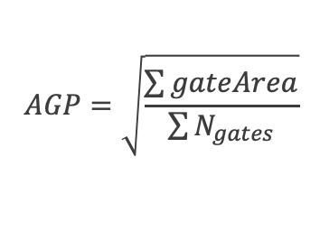
Where to cut 2D system ?
Analysis of implemented 2D design (after P&R)
Relative histograms of Number of Wires & Wire Length (WL)
X-axis uses Average Gate Pitch (AGP) to express WL (not absolute WL)
Observations
More than 45% of wires are of length smaller than 5 AGP
70% of WL_{tot} is in range of 0.1k & 2k gates (this is where we should cut)
AGP=0.245um
a)
b)
$$AGP=\sqrt{\frac{\sum{gateArea}}{\sum{N_{gates}}}}$$
70% of total WL

Slide 17
Possible gains of 3D ?
Measure of system connectivity (C):
inter-cluster WL
total system WL
MinCut → C is low & constant across different cluster size (std. 2D placement tools use MinCut)
MaxCut → cluster size impacts C
b)
c)
a)
Inter-function wirelength significant for smaller functionalities
Up to 80% of total WL taken by inter-function WL (potentially cut by 3D)
For clusters from 0.1 to1Kgates inter-function WL is 55-75% of total WL

Slide 18
Relation to 3D pitch
What about 3D nets count? Important since more 3D nets mean also finer 3D pitch
MaxCut generates up to 2 orders of magnitude more connections than MinCut (for the same design)
For MinCut & for smaller gate clusters no significant change
For MaxCut & smaller gate clusters → exponential rise in number of 3D connections
c)
a)
b)
To maximize benefits of 3D, system partitioning needs to be done with blocks of few hundreds gates resulting in many 3D pins
(i.e. we need fine 3D pitch & partitioning automation)

Slide 19
Examples of benefits

Slide 20
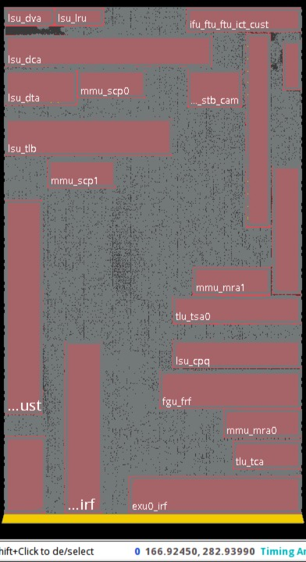
Demonstrators using die-by-die flow
Logic-on-Logic (no memory macros)
Synthetic SoC – 16 Low Density Parity Check (LDPC) blocks
Different connectivity to understand design impact on 3D gains
Manual functional partitioning at RTL-level
Possible in this case
Memory-on-Logic
OpenSPARCT2 – 8 core MPSoC for HPC (open source version of commercial product)
Looking at a single core
22 memories for L1 & register file sub-system
Automated netlist partitioning (generation of top/bottom & top-level netlists)
Mandatory due to Nº of blocks and connectivity

Slide 21
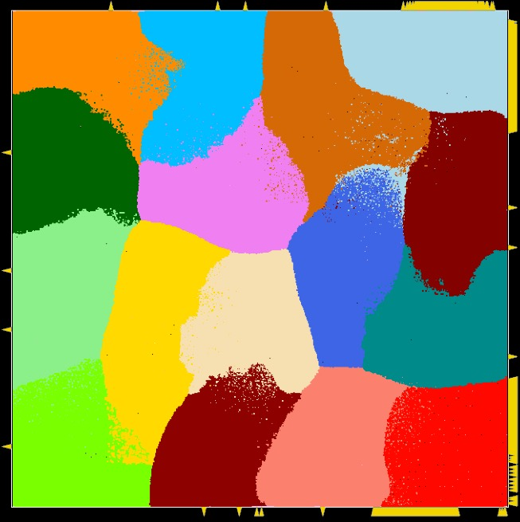
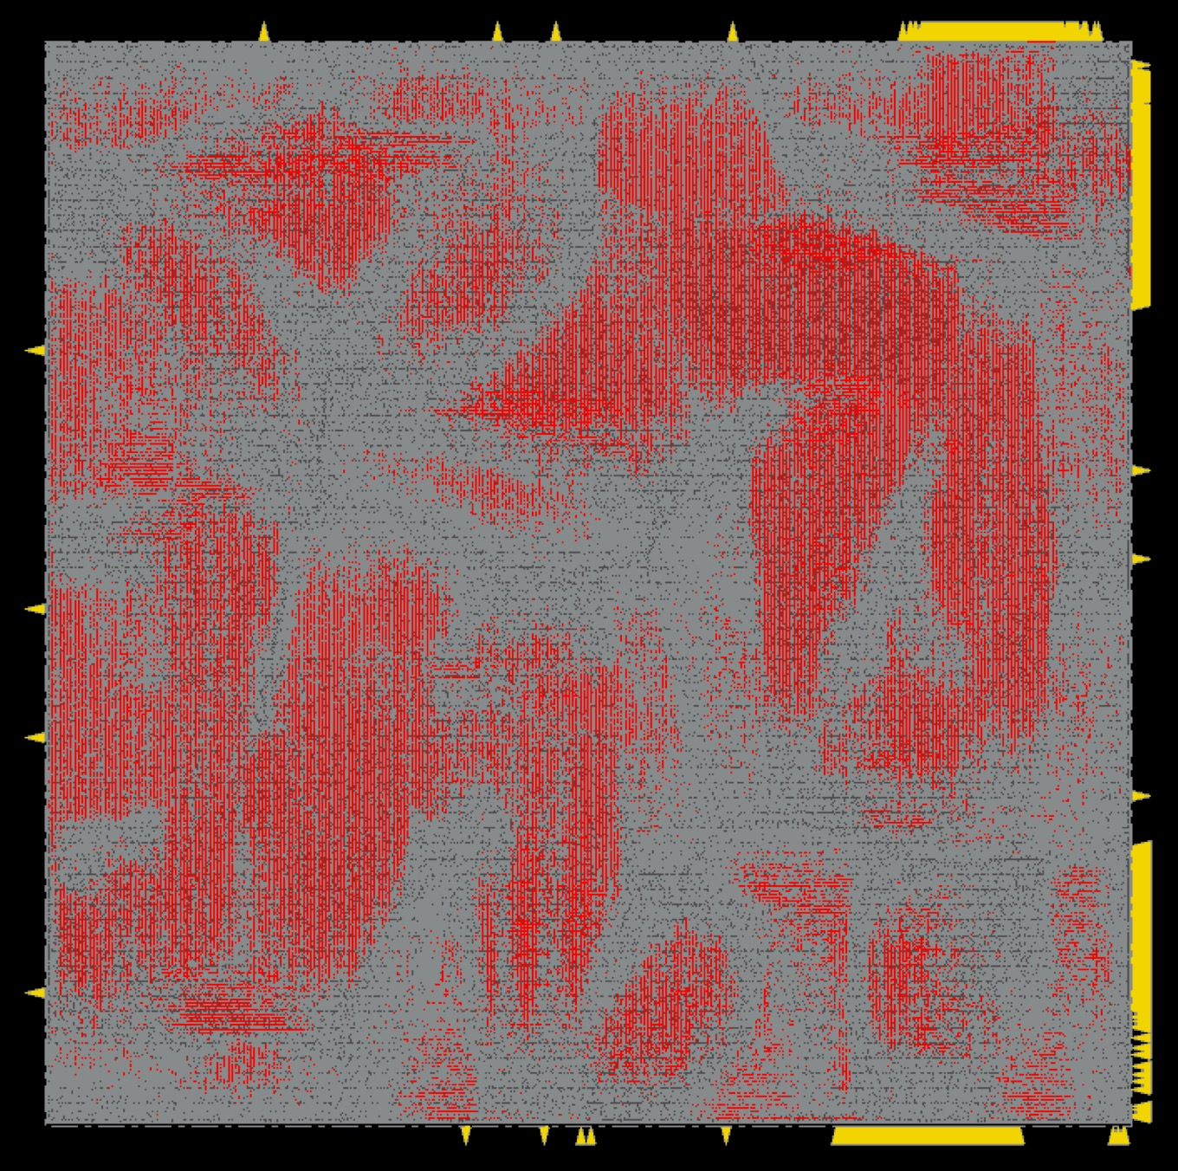
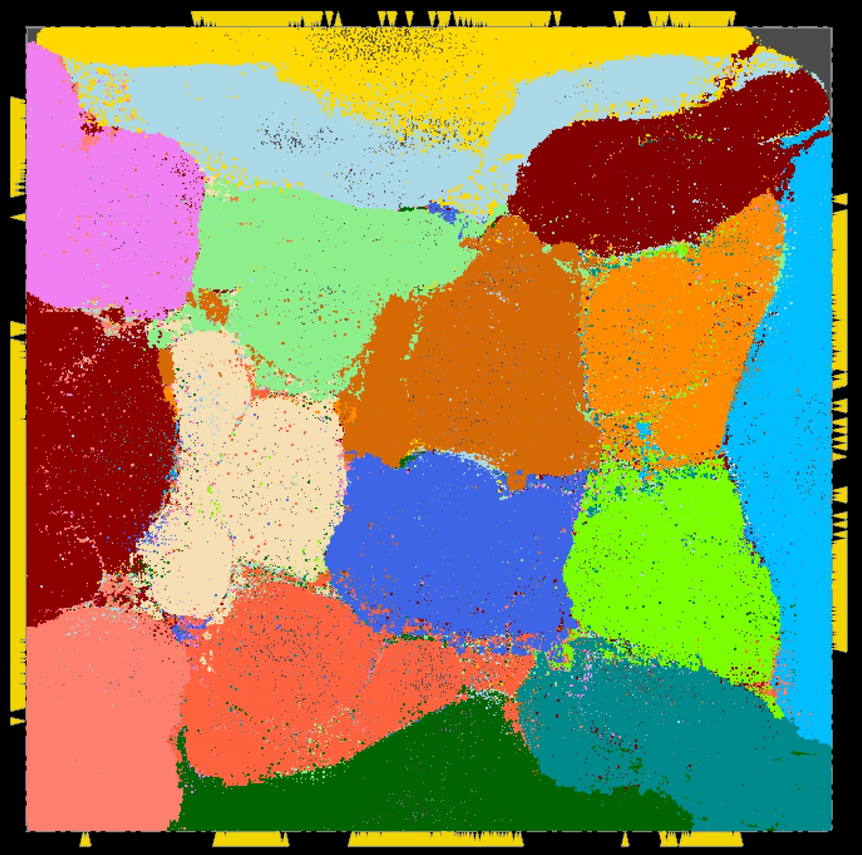
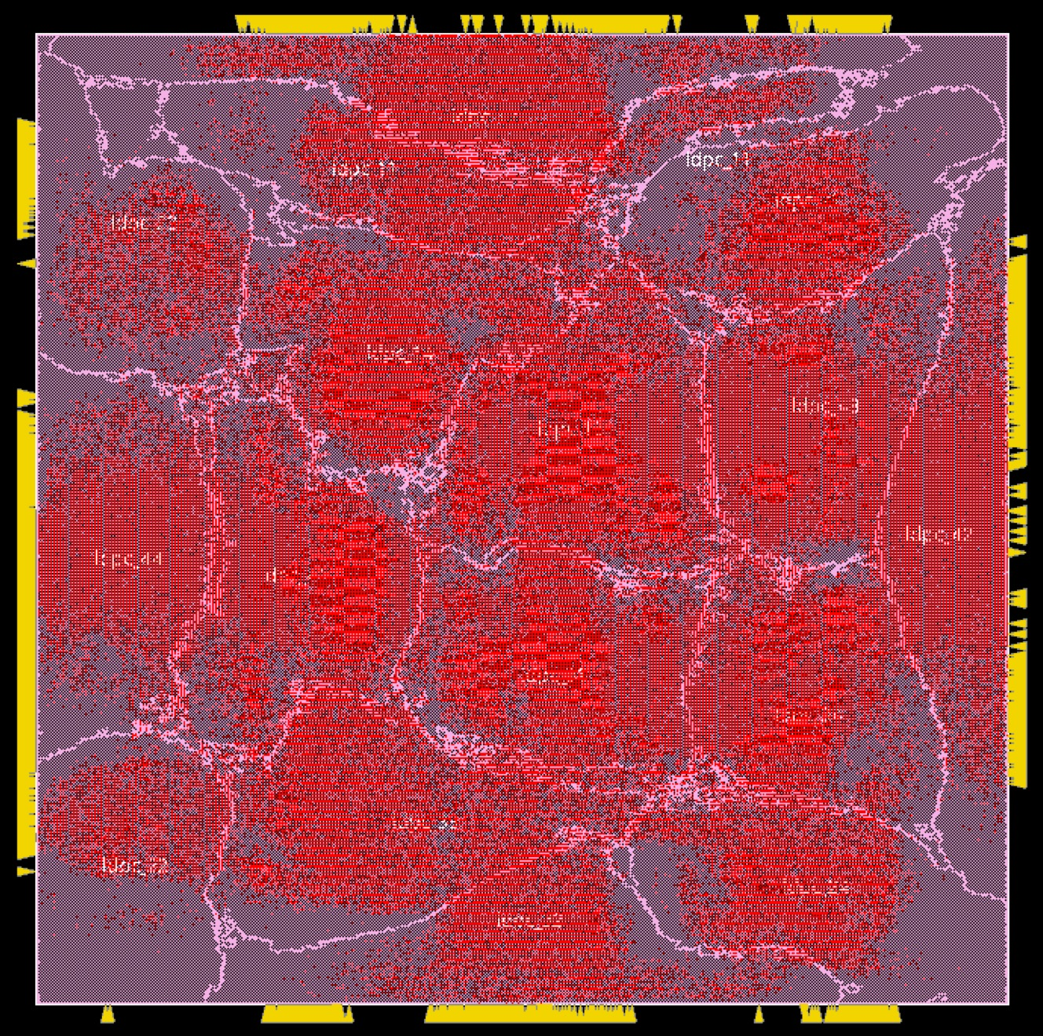
Logic-on-Logic SoC (16XLDPC)
a) Locally connected
2D P&R
Connectivity
Congestion
Full
connectivity
shown
b) Fully connected → more connectivity, more congestion, good for 3D
Partial
connectivity
shown

Slide 22
3D vs. 2D: WL & Area
3D design is compared with 2D with appropriate utilization to solve congestion (system routability)
Locally connected SoC → can’t benefit from 3D
Fully connected SoC → WL gains are in the range of 30%, depending on the 3D pitch
1um → -34%
2um → -23%
plus improved congestion allows die utilization increase in 3D resulting in area gains
Total die area of 3D is -24% compared to 2D
a)
c)
b)
c)

Slide 23
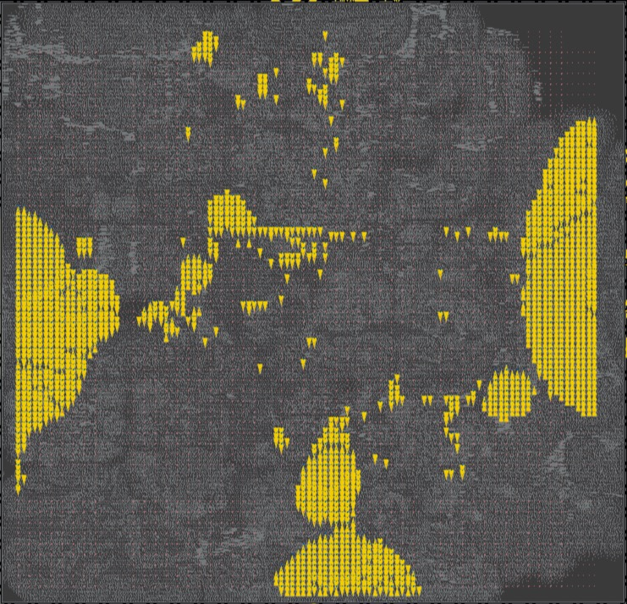
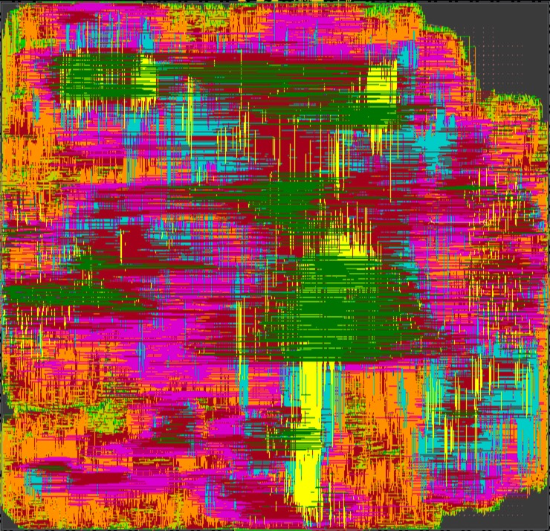
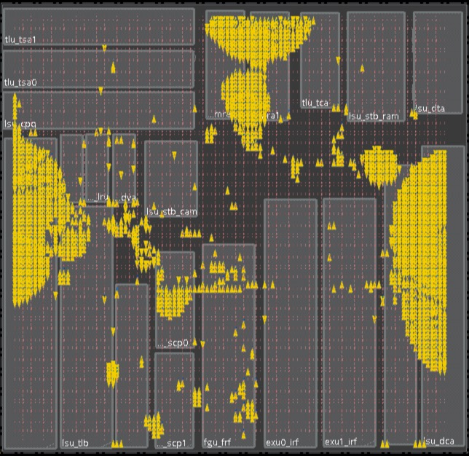
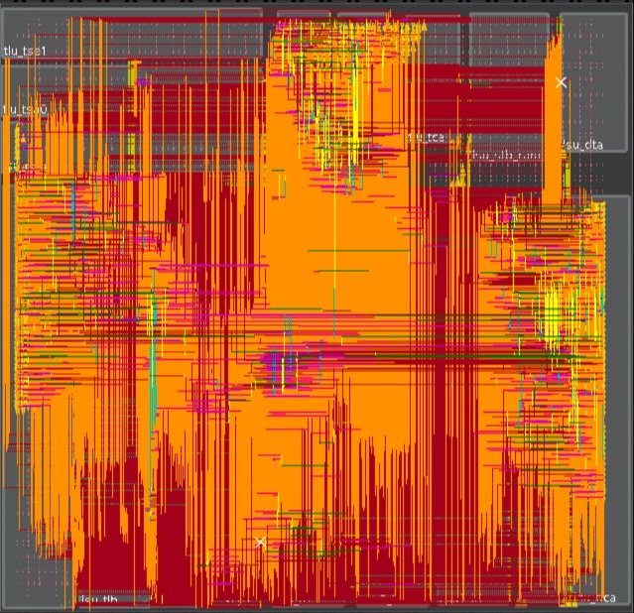
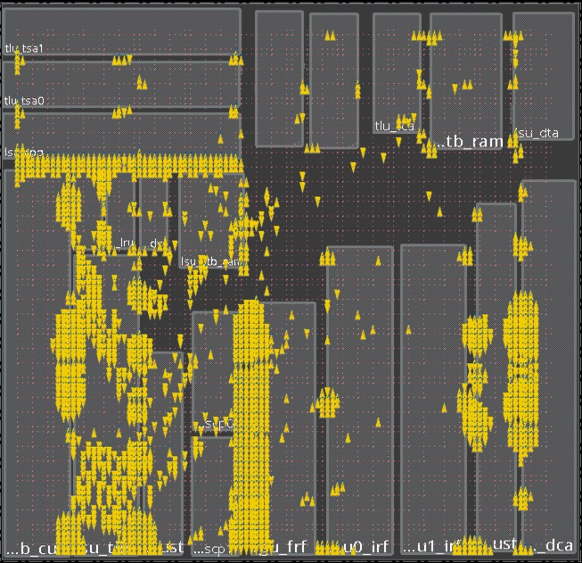
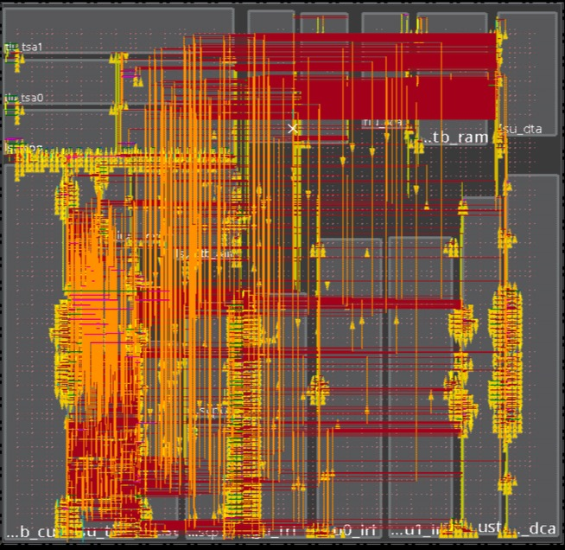
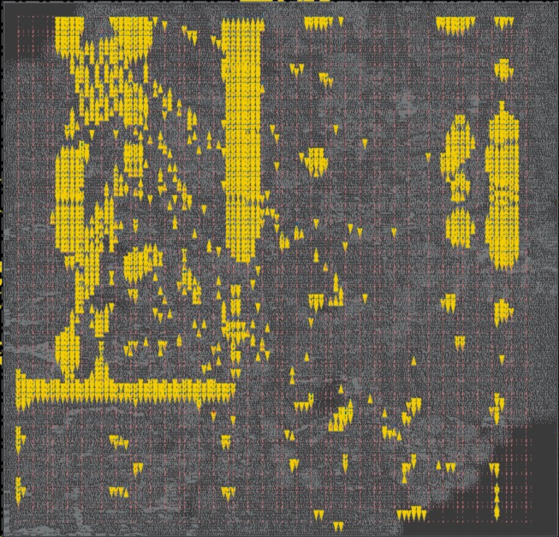
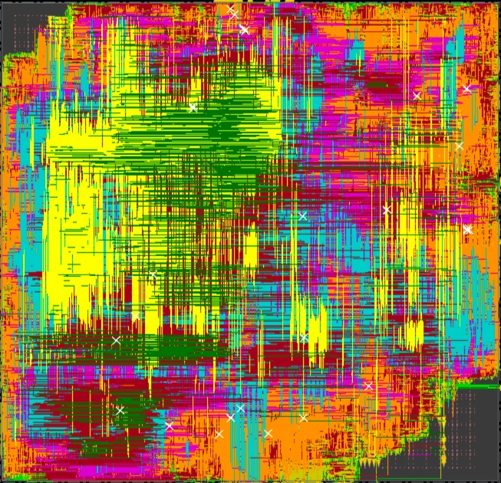
Memory-on-Logic: OpenSPARC core
a) Logic die first
Next die view flipped
1.5um
Bottom (logic die)
Top (mem. die)
b) Memory die first
1.5um
Top (mem. die)
Bottom (logic die)

Slide 24
2D vs. 3D WL distribution
Logic die first
3D saves from M4 and up (logic die)
→ Total WL reduction: -20%
Limited use of BEOL for memory die
Memory die first is better
→ 3D betters 2D by -28%
45% of critical path delay caused by wires Perf. improved by ~30%
a)
b)
c)
Bottom Die First
Top Die First

Slide 25
Summary & Conclusions

Slide 26
2D CMOS scaling continues, but not smoothly …
3D integration technologies could extend the life of CMOS
Complementary to device & standard cell scaling
Better perf, power & area (better silicon utilization, less buffering)
Fresh view of system integration (package-level integration)
Various flavors of functionally partitioned systems
Memory-on-Logic – better performance & possible cost gains due to process optimization for memory layer
Logic-on-Logic – for maximum performance benefits
Benefits tightly coupled to 3D technology parameters
Fine 3D interconnect pitch is required to maximize benefits
Optimization space not yet fully deployed, full flow still missing
Better clustering, partitioning methods etc.
Across die timing optimizations, 3D clock tree synthesis etc.

Slide 27
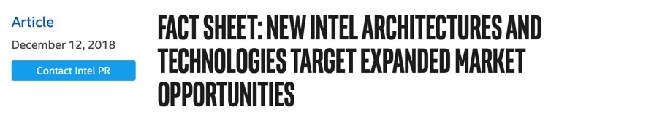
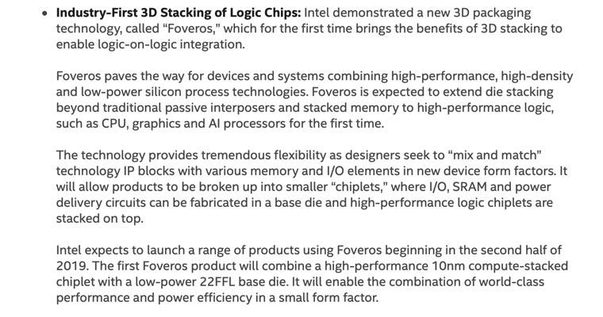
3D is not about research any more …
Thank you!

